Slide 1



Hanoi University of Science and Technology
School of Electronics and Telecommunication
Weekly Practice: Image Binary
Presenter: Vu Duc Thai
ĐTVT.08-K62
Instructor: Associate Prof. Le Thi Lan
Ha Noi, 5-2021

Slide 2
Outline
Boundary extraction and Region filling algorithm
Applications
Theoretical basic
Connected Components algorithm
Applications
Theoretical basic
Convex Hull algorithm
Applications
Theoretical basic
References
Practice code

Slide 3
I. Boundary Extraction and Region Filling Algorithm

Slide 4
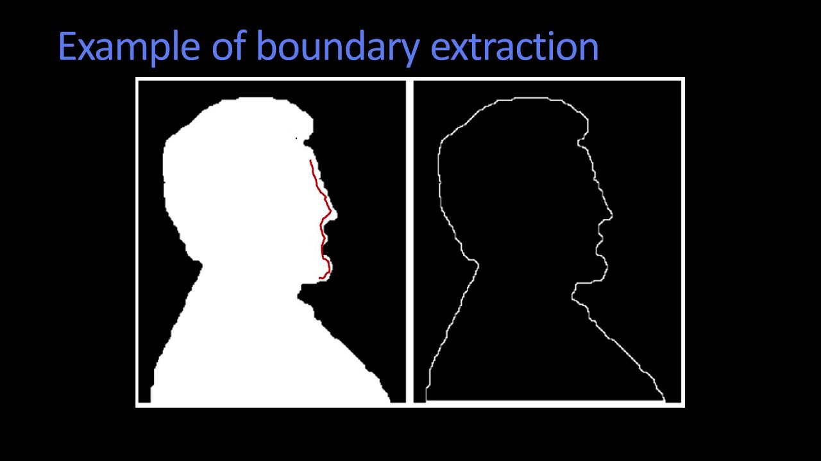

I. Boundary Extraction and Region Filling Algorithm
Boundary Extraction Algorithm | Region Filling Algorithm
I.a Applications

Slide 5
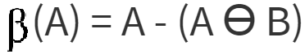

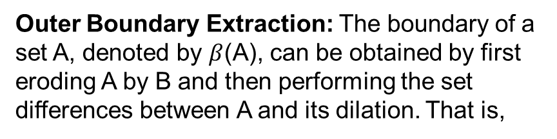
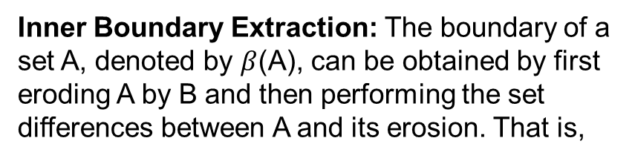
I. Boundary Extraction and Region Filling Algorithm
Boundary Extraction Algorithm | Region Filling Algorithm
I.b Theoretical basic
Inner Boundary Extraction: The boundary of a set A, denoted by $β$(A), can be obtained by first eroding A by B and then performing the set differences between A and its erosion. That is,
Let p be a pixel in a region surrounded by an 8-connected boundary, A. Region filling can be accomplished using an iterative procedure, mathematically expressed as follows:
Outer Boundary Extraction: The boundary of a set A, denoted by $β$(A), can be obtained by first eroding A by B and then performing the set differences between A and its dilation. That is,
Where X0 = p and B is the cross-shaped structuring element. The algorithm stops at the kth iteration if Xk = Xk-1. The union of Xk and A contains the original boundary (A) and all the pixels within it labeled as 1

Slide 6
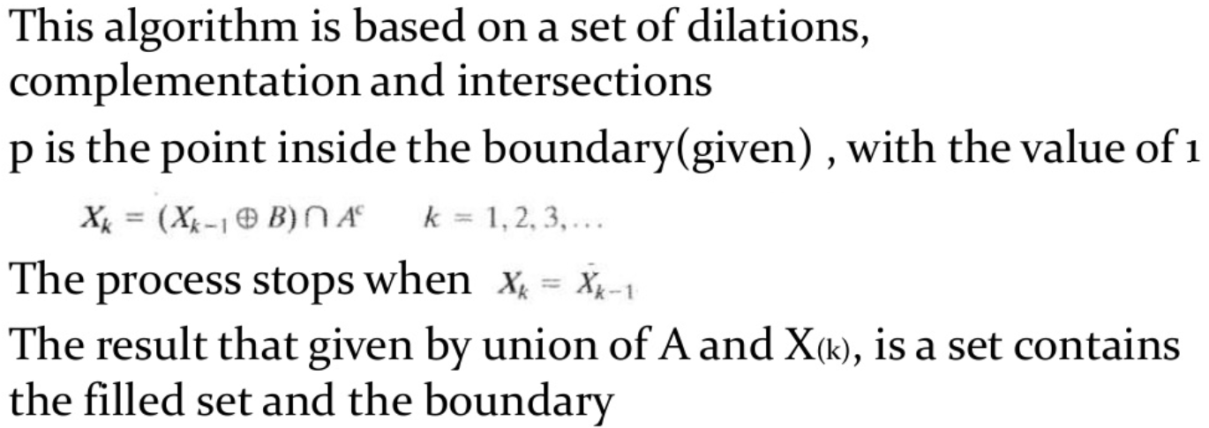
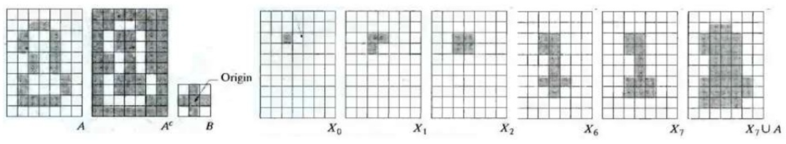
I.b Boundary Extraction and Region Filling Algorithm
Region Filling Algorithm

Slide 7
II. Connected Components Algorithm

Slide 8
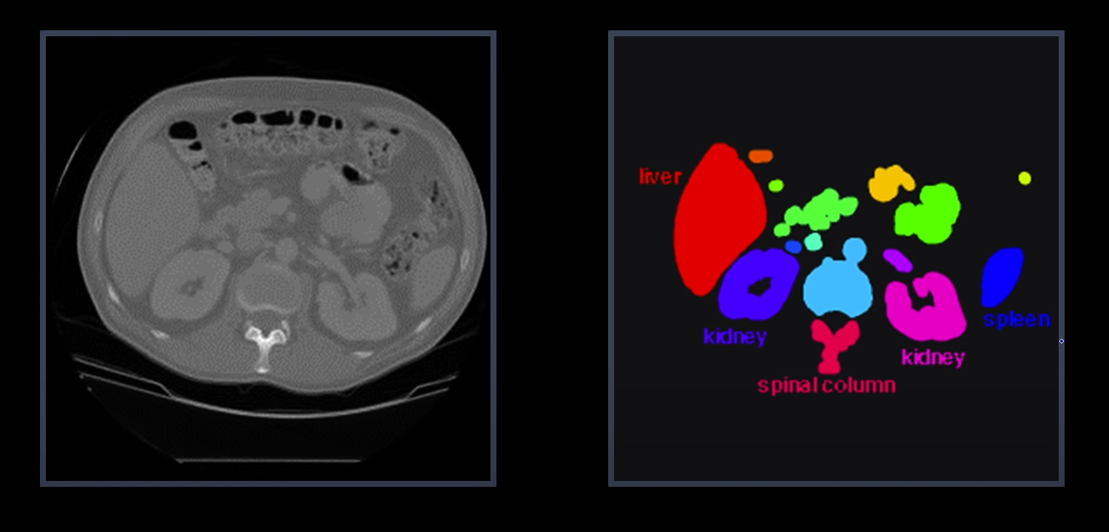
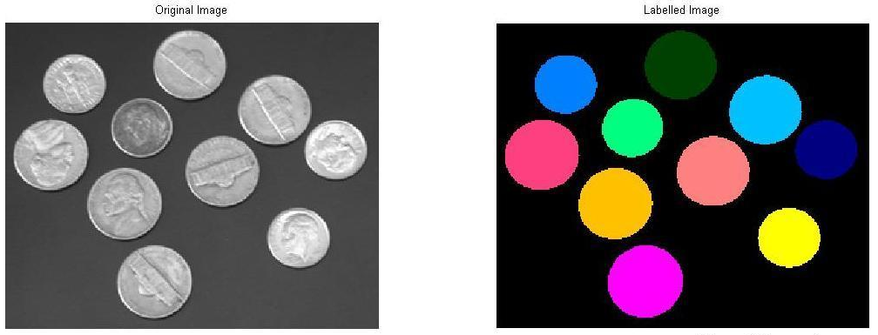
II. Connected Components Algorithm
II.a Application
CT image of the chest
Image Segmentation

Slide 9
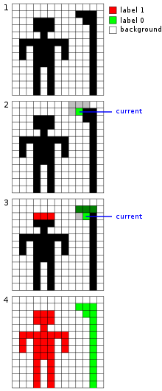
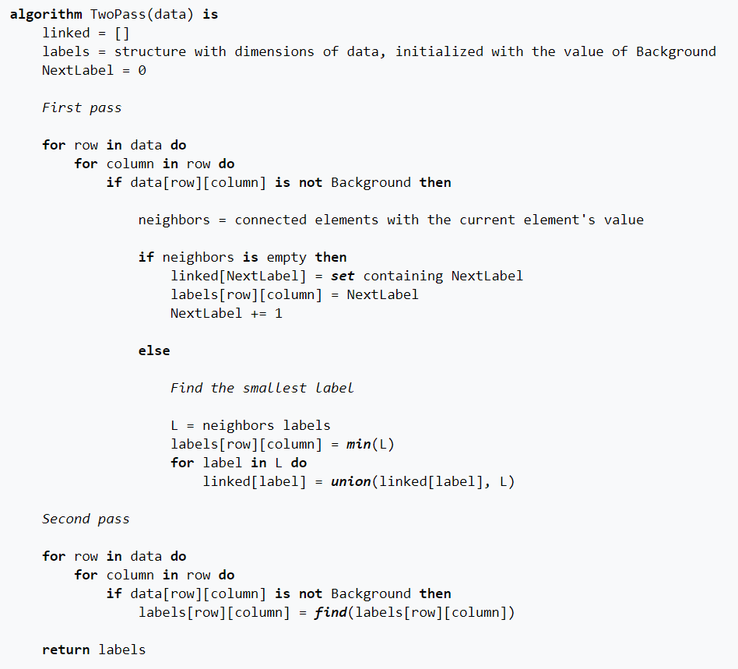


II. Connected Components Algorithm
Pseudocode for this algorithm:
II.b Theoretical basic
4-connectivity
8-connectivity

Slide 10
III. Convex Hull Algorithm

Slide 11
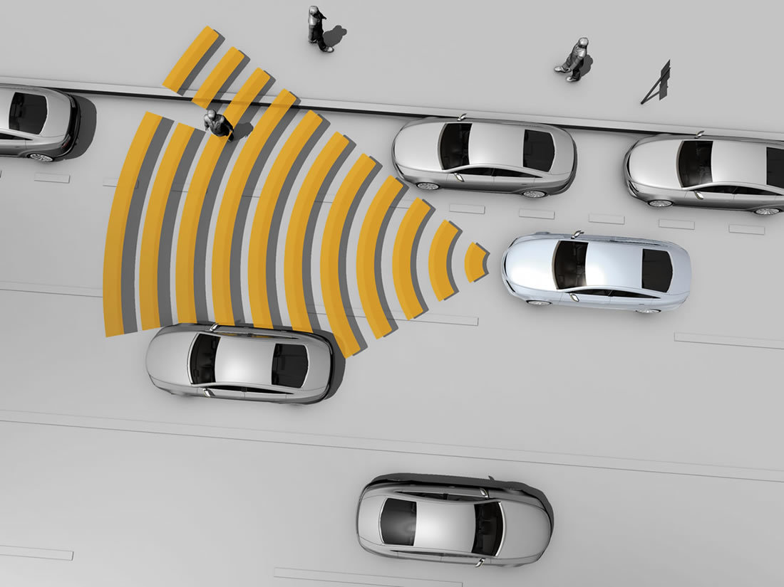
III. Convex Hull Algorithm
A few of the applications of the convex hull are:
Collision avoidance: If the convex hull of a car avoids collision with obstacles then so does the car. Since the computation of paths that avoid collision is much easier with a convex car, then it is often used to plan paths.
Smallest box: The smallest area rectangle that encloses a polygon has at least one side flush with the convex hull of the polygon, and so the hull is computed at the first step of minimum rectangle algorithms. Similarly, finding the smallest three-dimensional box surrounding an object depends on the 3D-convex hull.
Shape analysis: Shapes may be classified for the purposes of matching by their "convex deficiency trees", structures that depend for their computation on convex hulls.
III.a Application

Slide 12
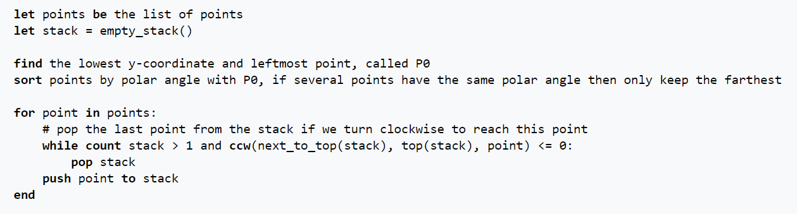
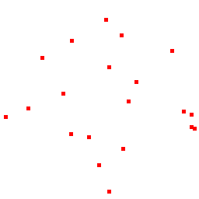
III. Convex Hull Algorithm
Pseudocode:
III.b Theoretical basic

Slide 13
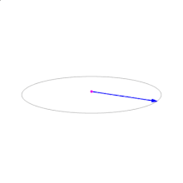
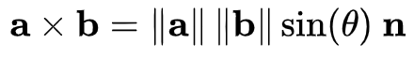
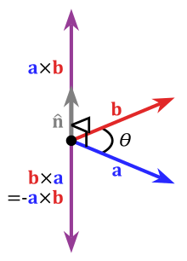
III. Convex Hull Algorithm
Cross Product
Where:
θ is the angle between a and b in the plane containing them (hence, it is between 0° and 180°)
‖a‖ and ‖b‖ are the magnitudes of vectors a and b
n is a unit vector perpendicular to the plane containing a and b, in the direction given by the right-hand rule (illustrated).
If the vectors a and b are parallel (i.e., the angle θ between them is either 0° or 180°), by the above formula, the cross product of a and b is the zero vector 0.

Slide 14
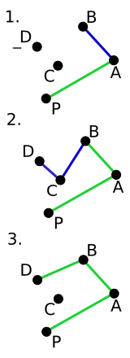
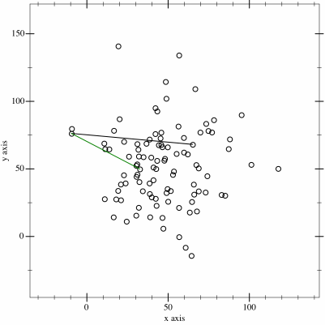
III. Convex Hull Algorithm
A special case: As one can see, PAB and ABC are counterclockwise, but BCD is not. The algorithm detects this situation and discards previously chosen segments until the turn taken is counterclockwise (ABD in this case.)

Slide 15
III. Convex Hull Algorithm
Python Libraries:
Here are a few options for computing convex hulls in your projects.
SciPy
Scikit-image
OpenCV

Slide 16
IV. References
Boundary extraction and Region filling algorithm
https://www.youtube.com/watch?v=NTTVQYEG6XM&t=109s&ab_channel=KnowledgeAmplifier
https://www.slideshare.net/daouddodo/chapter-9-morphological-image-processing-71788791
Connected Components algorithm
https://en.wikipedia.org/wiki/Connected-component_labeling
Convex Hull algorithm
https://en.wikipedia.org/wiki/Gift_wrapping_algorithm
https://brilliant.org/wiki/convex-hull/#:~:text=A%20few%20of%20the%20applications,often%20used%20to%20plan%20paths.
https://en.wikipedia.org/wiki/Graham_scan

Slide 17
V. Practice Code

Slide 18

Thank you for listening

